Slide 1
FUNDAMENTALS OF
HARDWARE AND WINDOWS

Slide 2
Motherboard:

Slide 3
W I N D O W S FUNDAMENTALS

Slide 4
TYPES OF OPERATING SYSTEM
Network OS
Distributed OS
Multi-Tasking OS
Real-Time OS
Types of Processors
Multithreading
Hyper-Threading

Slide 5
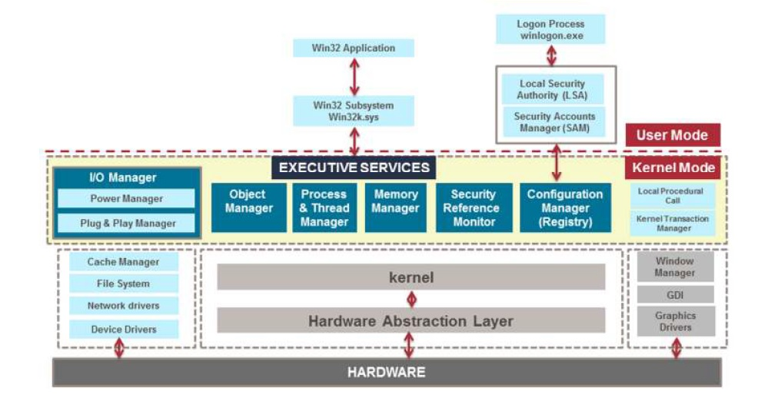
A kernel manages computer and the hardware - most notably memory and CPU time.
Monolithic
Micro Kernel
Hybrid

Slide 6
MBR
Boot sector
Boot manager (bootmgr)
Boot Loader (winload.exe)
Loads Kernel
BIOS
BCD
Phase 0 Loads Kernel Ntoskrnl.exe
Processor
Phase 1
SMPS
Session manager sub system smss.exe
csrss.exe
Session 0
Session 1
Explorer Initialization

Slide 7
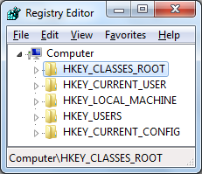
Windows Registry Editor
Windows Services
Windows Update
Firewall
Windows Time
Notes:
A cor AZUL sempre tem que aparecer no slide. Seja nas formas ou no texto.
Uma imagem como essa nao funciona. Muito “Barbie” para uma consultoria. Eles gostam deste layout mas deveria estar separador de capitulos com o logo de “espadas” maior. Para toda insercao de imagem o fundo deve ser cinza claro.

Slide 8
Power Manager:
S0 | All the components uses full power
S1 (Light Sleep) | Power consumption greater than s2, less than s0.
S2 (Deep Sleep) | Power consumption greater than s3, less than s1.
S3 (Deepest Sleep) | Only one of the components is consuming power.
S4 (Hibernating) | Least amount of power is getting used.
S5 (Fully off) | No components are using power.

Slide 9
Types of File System:
File Allocation Table (FAT)
New Technology File System (NTFS)
Boot sector | FAT | FAT Copy | Files and Folders
Boot sector | Master File Table( MFT) | Files | MFT Copy

Slide 10
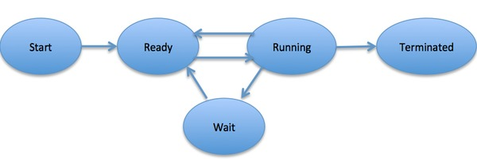
Process:
A process is a program in execution.

Slide 11
VIRTUAL MEMORY
Memory management capability of an OS that uses hardware and software to allow a computer to compensate for physical memory shortages by temporarily transferring data from random access memory (RAM) to disk storage.
PAGING
In computer operating systems, paging is a memory management scheme by which a computer stores and retrieves data from secondary storage for use in main memory.
In this scheme, the operating system retrieves data from secondary storage in same-size blocks called pages.

Slide 12
L I N U X FUNDAMENTALS

Slide 13
Advantages of Linux
Software Versions
Open source
Flexible
Performance
Alpha
Beta
Security
Multi Tasking
Notes:
A cor AZUL sempre tem que aparecer no slide. Seja nas formas ou no texto.
Uma imagem como essa nao funciona. Muito “Barbie” para uma consultoria. Eles gostam deste layout mas deveria estar separador de capitulos com o logo de “espadas” maior. Para toda insercao de imagem o fundo deve ser cinza claro.

Slide 14
LINUX Subsystem
User Applications
Operating System Services
Kernel
Hardware Controllers

Slide 15
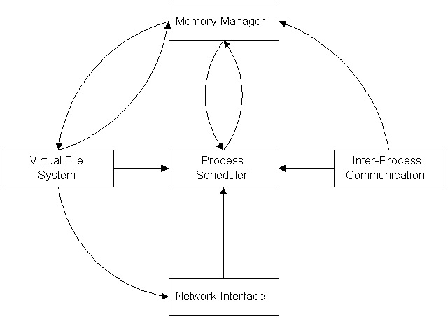
Kernel Subsystem

Slide 16
Booting
Power on
Process boot time menu
BIOS
GRUB loads kernel image
& initial RAM disk
Load stage 1 GRUB from MBR
Kernel mount root file system
Load stage 1.5 then stage 2 of GRUB
Kernel runs init
GRUB reads menu.lst
init runs script to start
user level services

Slide 17
Run levels
Run levels | Mode
0 | Shut down the system
1 | Single user mode
2 | Basic multiuser mode without NFS
3 | Full multiuser mode (Text based)
4 | Un used
5 | Multiuser mode with GUI
6 | Reboot system

Slide 18
Shell
It provides command line user interface.
Used by the operating system as facility of control.
Shell converts function calls into system calls.
Examples : bash, t- shell, c- shell, etc.
USER
SHELL
KERNEL
HARDWARE

Slide 19
File System
Boot
block
Block Group 0
Block Group 1
…
Block
Group n
SUPER
Block
Group Descriptor
Data
Block
Bitmap
iNode
Block
Bitmap
iNode
Block
Data
Block

Slide 20
Journaling
Types
Write Back
Ordered
Journal

Slide 21
Scheduling Algorithm
Types
FCFS
Round Robin
SJF
Priority Based

Slide 22
Types of Process
Automated
Batch
Zombie
Parent
Child
Real Time
Interactive
Orphans
Daemon

Slide 23
Team - 04
Shabnam Swain
Debleena Biswas
Aniket Gidvir
Nikitha Narahari
Priya Gunjal
Pawankumar Chidurala
...Thank you

Slide 24
OSI PHYSICAL LAYER

Slide 25
FUNCTIONS OF PHYSICAL LAYER
HARDWARE SPECIFICATIONS
ENCODING AND SIGNALING
DATA TRANSMISSION AND RECEPTION
TOPOLOGY AND PHYSICAL NETWORK DESIGN

Slide 26
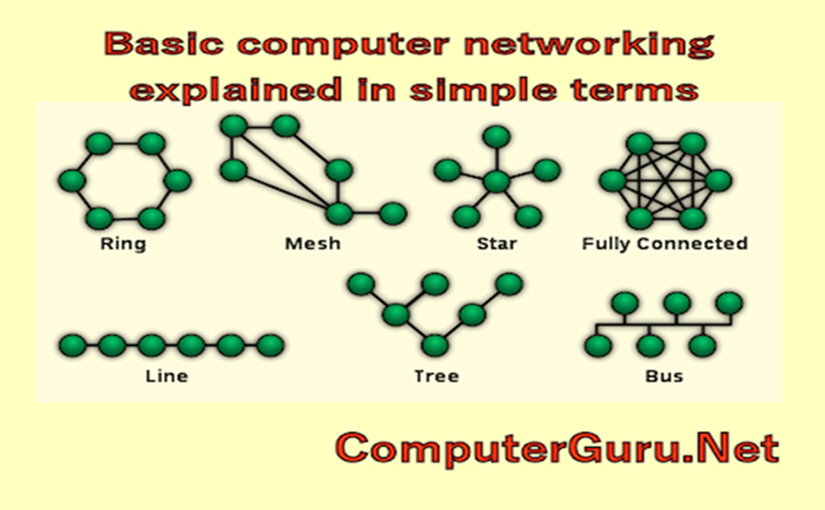
TOPOLOGY OF PHYSICAL LAYER

Slide 27
SERVICES IN PHYSICAL LAYER
BIT BY BIT DELIVERY
TRANSMISSION MEDIUM
MODULATION
LINE CODING

Slide 28
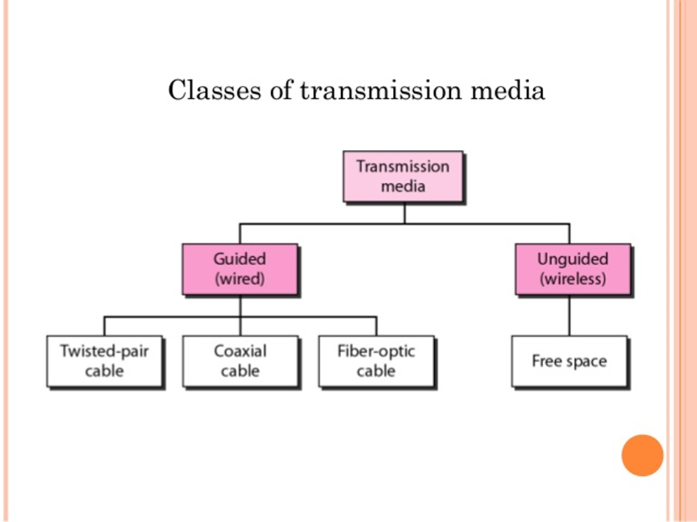
TRANSMISSION MEDIUM

